Slide 1

Trees: Definition and Properties Binary Tree
Data Structure | Tree and Heap
Course: Data Structure | Chapter: Tree and Heap | Program: Bachelor of Engineering | Institution: Chandigarh University
DISCOVER · LEARN · EMPOWER
Notes:
Welcome everyone to today's session on Trees and Heaps. We are focusing specifically on the foundational definitions and properties of Binary Trees. This topic is critical for understanding more complex data structures like Heaps and Binary Search Trees later in the course.

Slide 2
Course Outcomes
SLIDE 2 / 14
Course Outcome
CO | BT LEVEL | DESCRIPTION
CO1 | BT1 | Understand and apply basic data structures, algorithms, complexity analysis, ADTs, arrays and linked lists.
CO2 | BT2 | Apply and implement stacks and queues in problem-solving.
CO3 | BT3 | Analyse and apply searching, sorting, and hashing techniques.
CO4 | BT4 | Construct and apply tree structures and traversal techniques.
CO5 | BT5 | Represent and solve graph problems using DFS, BFS, and graph algorithms.
Chandigarh University
2 / 14
Notes:
Today's lecture directly addresses CO4 by teaching you how to construct and analyze tree structures. We will also touch upon CO5, as trees are a specific type of graph used in DFS and BFS algorithms. Understanding these outcomes ensures you can apply these concepts to real-world problem solving.

Slide 3
Learning Objectives
SLIDE 3 / 14
Learning Outcomes
1
Define a tree and list its fundamental structural properties.
2
Analyze the specific constraints and characteristics of a Binary Tree.
3
Calculate the maximum number of nodes for a given tree height.
4
Distinguish between different types of binary trees based on properties.
5
Identify common pitfalls when implementing tree traversal logic.
Chandigarh University
3 / 14
Notes:
By the end of this lecture, you will be able to define a tree and list its fundamental structural properties. You will analyze the specific constraints of a Binary Tree and calculate the maximum number of nodes for a given height. Finally, you will distinguish between different types of binary trees and identify common implementation pitfalls.

Slide 4
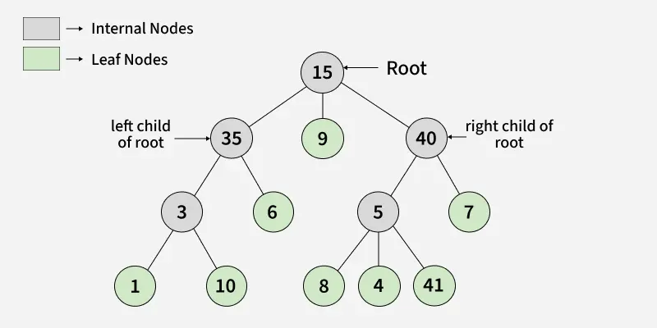
Lecture
SLIDE 4 / 14
Definition of a Tree Structure
1
A tree is a finite set of one or more nodes with a hierarchical relationship.
2
The topmost node is called the root and has no parent node.
3
Every node except the root has exactly one parent node.
4
Nodes with no children are called leaf nodes or external nodes.
5
A tree with zero nodes is defined as an empty tree.
6
The relationship between parent and child defines the tree hierarchy.
Introduction to Tree Data Structure - GeeksforGeeks
Chandigarh University
4 / 14
Notes:
Think of a tree like a family genealogy chart where the root is the ancestor. Every node except the root has exactly one parent, ensuring a single path from the root to any node. Nodes with no children are called leaf nodes, representing the end of a branch. This hierarchical structure is the foundation for all tree-based algorithms.

Slide 5
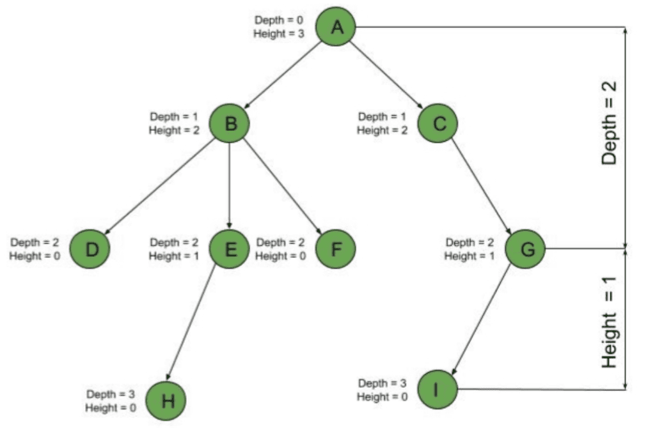
Lecture
SLIDE 5 / 14
Key Properties of Trees
1
The path length is the number of edges on the path from root.
2
The depth of a node is the length of the path from root.
3
The height of a tree is the maximum depth of any node.
4
The degree of a node is the number of subtrees it contains.
5
The level of a node is its depth plus one, starting at 1.
6
A tree with N nodes always has exactly N minus 1 edges.
Source: www.baeldung.com
Chandigarh University
5 / 14
Notes:
The depth of a node is the length of the path from the root to that specific node. The height of a tree is the maximum depth of any node in the entire structure. A tree with N nodes always has exactly N minus 1 edges, which is a crucial property for validation. Understanding these properties helps in analyzing the efficiency of tree operations.

Slide 6
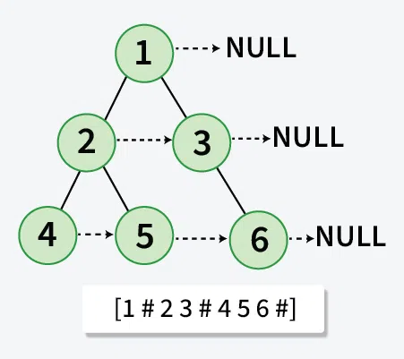
Lecture
SLIDE 6 / 14
Definition of a Binary Tree
1
A binary tree is a tree where each node has at most two children.
2
The two children are distinctively labeled as the left child and right child.
3
Unlike general trees, the order of children matters in a binary tree.
4
A node can have zero, one, or two children in a binary tree.
5
An empty binary tree is a valid state with zero nodes.
6
The left and right subtrees are themselves binary trees recursively.
Source: media.geeksforgeeks.org
Chandigarh University
6 / 14
Notes:
A binary tree is a tree where each node has at most two children, labeled left and right. Unlike general trees, the order of children matters in a binary tree, making left distinct from right. A node can have zero, one, or two children, and an empty binary tree is a valid state. This distinction is vital for algorithms like binary search.

Slide 7
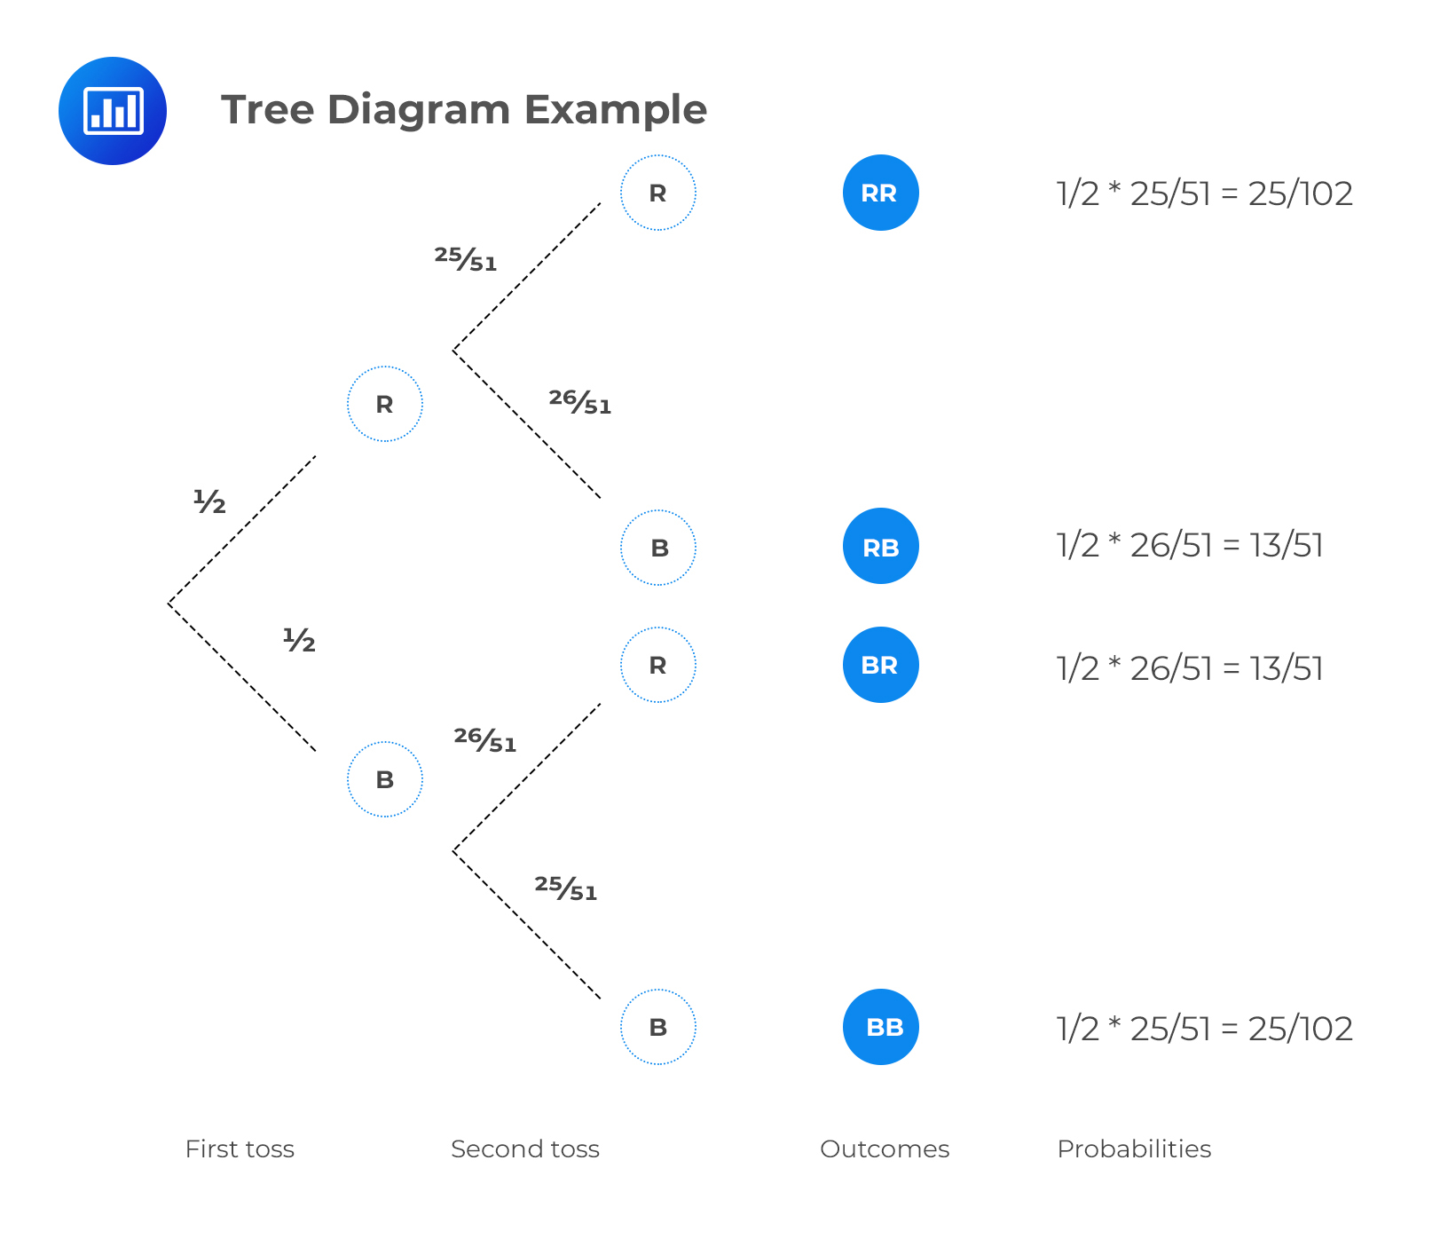
Lecture
SLIDE 7 / 14
Properties of Binary Trees
1
The maximum number of nodes at level L is 2 to the power of L minus 1.
2
The maximum number of nodes in a binary tree of height H is 2 to the power of H plus 1 minus 1.
3
The minimum number of nodes in a binary tree of height H is H plus 1.
4
The minimum height of a binary tree with N nodes is floor of log base 2 of N plus 1.
5
A binary tree with N nodes has exactly N plus 1 null pointers.
6
The number of leaf nodes is always one more than the number of nodes with degree 2.
Source: analystprep.com
Chandigarh University
7 / 14
Notes:
The maximum number of nodes at level L is 2 to the power of L minus 1, starting from level 1. The maximum number of nodes in a binary tree of height H is 2 to the power of H plus 1 minus 1. The minimum number of nodes in a binary tree of height H is H plus 1. These properties help us estimate memory usage and algorithm complexity.

Slide 8
Lecture
SLIDE 8 / 14
Types of Binary Trees
1
A full binary tree has every node with either zero or two children.
2
A complete binary tree fills all levels except possibly the last one.
3
A perfect binary tree is full and complete with all leaves at same level.
4
A degenerate tree has every node with only one child, acting like a list.
5
A skewed tree is either left-skewed or right-skewed based on child placement.
6
Understanding types helps in choosing the right data structure for specific tasks.
Chandigarh University
8 / 14
Notes:
A full binary tree has every node with either zero or two children, ensuring no node has just one child. A complete binary tree fills all levels except possibly the last one, which is filled from left to right. A perfect binary tree is full and complete with all leaves at the same level. Understanding these types helps in choosing the right data structure for specific tasks.

Slide 9

Worked Example
SLIDE 9 / 14
Node Calculation
GOVERNING EQUATION
Formula: Max Nodes = 2 to the power of H plus 1 minus 1
CALCULATION
32 minus 1 equals 31 nodes maximum for height 4.
VERIFY WITH LEVEL SUMS
1 + 2 + 4 + 8 + 16 equals 31 nodes.
• Calculate max nodes for a binary tree of height 4 using the formula.
• Substitute H = 4: Max Nodes = 2 to the power of 5 minus 1.
• This calculation assumes a perfect binary tree structure for maximum capacity.
Source: theyieldgrid.com
Chandigarh University
9 / 14
Notes:
Let's calculate the max nodes for a binary tree of height 4 using the formula. The formula is Max Nodes equals 2 to the power of H plus 1 minus 1. Substituting H equals 4, we get 2 to the power of 5 minus 1. This calculation yields 32 minus 1, which equals 31 nodes maximum for height 4. This verification assumes a perfect binary tree structure for maximum capacity.

Slide 10
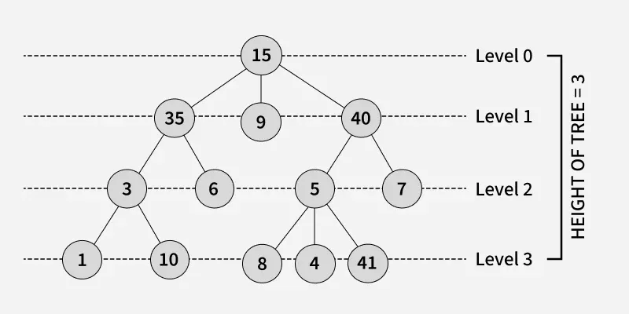
Worked Example
SLIDE 10 / 14
Height Calculation
GOVERNING EQUATION
Formula: Min Height = floor of log base 2 of N plus 1
CALCULATION
log base 2 of 15 is approximately 3.9, floor is 3.
RESULT
Minimum height is 3 plus 1, which equals 4 levels.
• Find minimum height for a binary tree with 15 nodes.
• Substitute N = 15: Min Height = floor of log base 2 of 15 plus 1.
• This represents the most compact arrangement of 15 nodes possible.
Source: media.geeksforgeeks.org
Chandigarh University
10 / 14
Notes:
Find the minimum height for a binary tree with 15 nodes using the formula. The formula is Min Height equals floor of log base 2 of N plus 1. Substituting N equals 15, we get floor of log base 2 of 15 plus 1. The calculation shows log base 2 of 15 is approximately 3.9, and the floor is 3. The result is a minimum height of 3 plus 1, which equals 4 levels.

Slide 11
Lecture
SLIDE 11 / 14
Common Pitfalls in Trees
1
Confusing tree height with depth can lead to incorrect algorithm complexity.
2
Assuming all binary trees are balanced leads to poor performance estimates.
3
Ignoring null pointers causes segmentation faults during traversal implementations.
4
Mixing up left and right children violates the binary tree definition.
5
Forgetting that a single node tree has height 1, not 0.
6
Overlooking the N plus 1 null pointers property in memory analysis.
Chandigarh University
11 / 14
Notes:
Confusing tree height with depth can lead to incorrect algorithm complexity and performance issues. Assuming all binary trees are balanced leads to poor performance estimates in worst-case scenarios. Ignoring null pointers causes segmentation faults during traversal implementations, which is a common crash source. Mixing up left and right children violates the binary tree definition and breaks search logic.

Slide 12
Lecture
SLIDE 12 / 14
Why Properties Matter
1
Properties determine the time complexity of search, insert, and delete operations.
2
Knowing node counts helps in allocating optimal memory for tree structures.
3
Height constraints dictate the worst-case scenario for algorithm execution time.
4
Understanding types guides the selection of appropriate tree algorithms.
5
Mathematical bounds provide guarantees for system performance and reliability.
6
These properties form the basis for advanced structures like Heaps and BSTs.
Chandigarh University
12 / 14
Notes:
Properties determine the time complexity of search, insert, and delete operations, which is crucial for performance. Knowing node counts helps in allocating optimal memory for tree structures in embedded systems. Height constraints dictate the worst-case scenario for algorithm execution time, ensuring reliability. These properties form the basis for advanced structures like Heaps and Binary Search Trees.

Slide 13
Lecture
SLIDE 13 / 14
Key Takeaways
1
A tree is a hierarchical structure with a single root and N minus 1 edges.
2
Binary trees restrict each node to at most two distinct children.
3
Maximum nodes at level L is 2 to the power of L minus 1.
4
Minimum height for N nodes is floor of log base 2 of N plus 1.
5
Distinguishing tree types is essential for efficient algorithm design and implementation.
Chandigarh University
13 / 14
Notes:
A tree is a hierarchical structure with a single root and N minus 1 edges, forming the basis of our study. Binary trees restrict each node to at most two distinct children, creating a specific hierarchy. Maximum nodes at level L is 2 to the power of L minus 1, a key formula to remember. Minimum height for N nodes is floor of log base 2 of N plus 1, defining the most compact tree. Distinguishing tree types is essential for efficient algorithm design and implementation.

Slide 14
Lecture
SLIDE 14 / 14
References
DATA STRUCTURES
A Pseudocode Approach with C — Gilberg, Forouzan
• Data Structures — Lipschutz
• Data Structure Using C — AK Sharma
• C and Data structure — P. S. Deshpandey
Chandigarh University
14 / 14
Notes:
Please refer to the recommended textbooks for further reading and practice problems. 'Data Structures: A Pseudocode Approach with C' by Gilberg and Forouzan provides excellent pseudocode examples. 'Data Structures' by Lipschutz offers a comprehensive theoretical foundation. 'Data Structure Using C' by AK Sharma and 'C and Data structure' by P. S. Deshpandey are also essential resources for this course.

